Slide 1

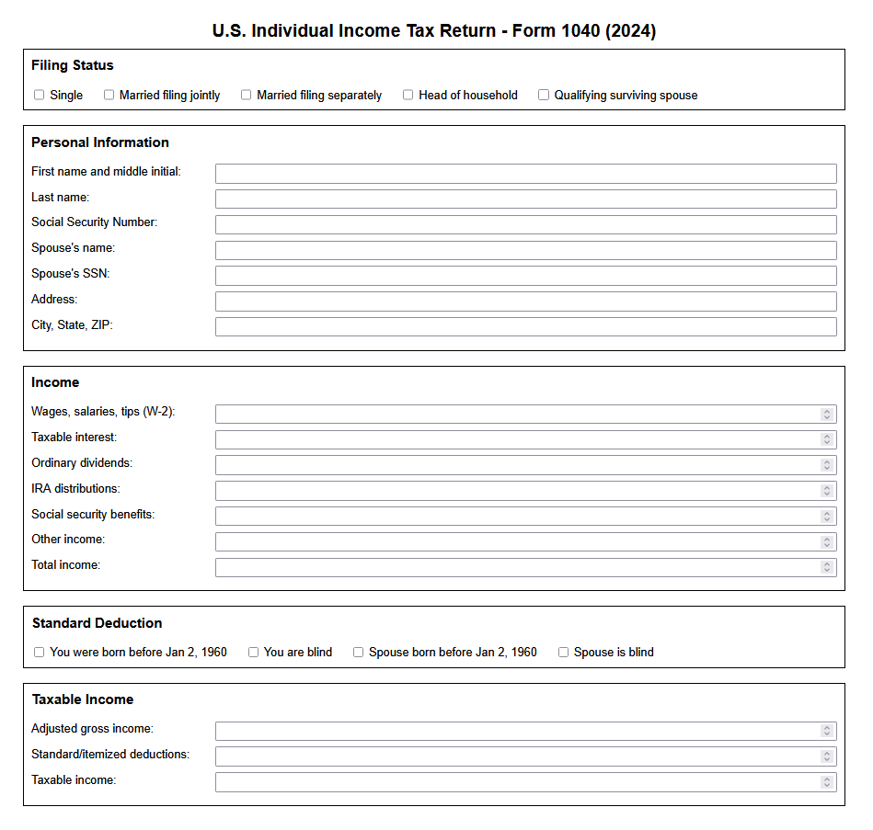
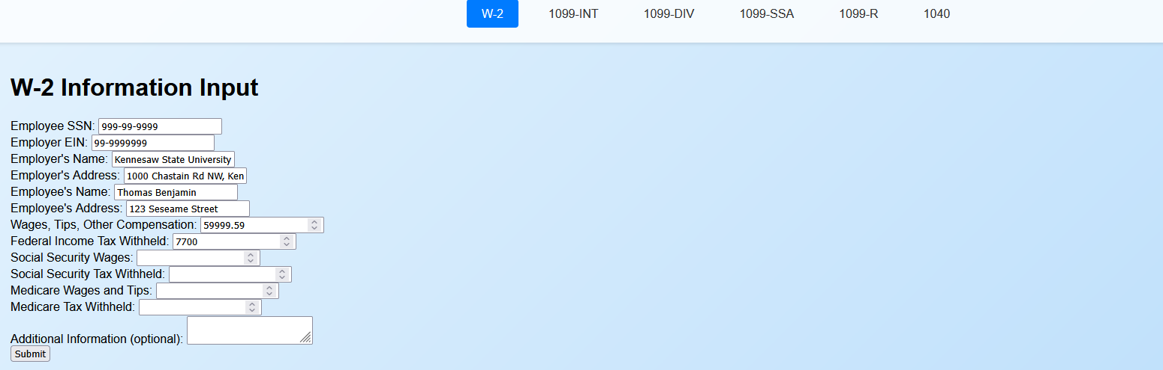
Tax Return Summary Generator
Alexander LaFave
Python based application that enables user input within a browser-based application to replicate source documents and generate income summaries, which are consolidated on a summary page mirroring page one of a personal tax return.
Summary
Input Pages

